Slide 1
Digital Systems and Number Systems
Unit -1

Slide 2
Digital Systems and Binary Numbers
 Digital age and information age
 Digital computers
◆ General purposes
◆ Many scientific, industrial and commercial applications
 Digital systems
◆ Telephone switching exchanges
◆ Digital camera
◆ Electronic calculators,
◆ Digital TV

Slide 3
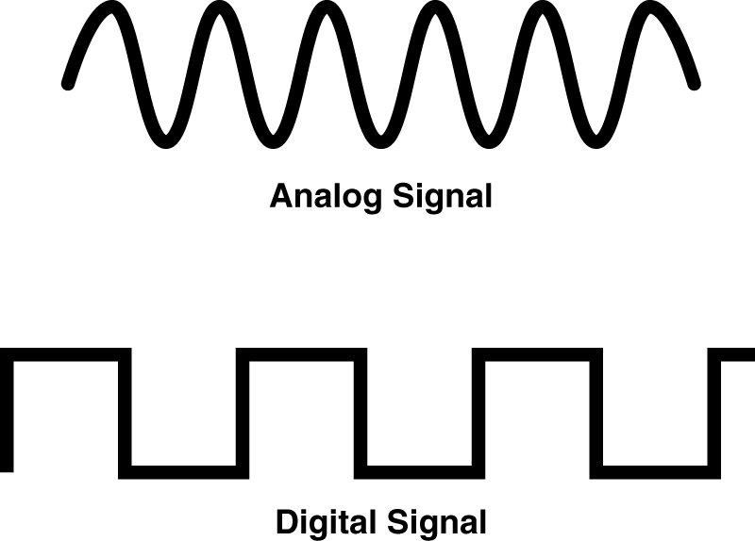
Analog and Digital Signal
 Analog system
◆ The physical quantities or range.
 Digital system
◆ The physical quantities or
◆ Greater accuracy
signals may vary continuously over a specified
signals can assume only discrete values.

Slide 4
Decimal Number System
 Base (also called radix) = 10
◆ 10 digits { 0, 1, 2, 3, 4, 5, 6, 7, 8, 9
 Digit Position
◆ Integer & fraction
 Digit Weight
}
2
1
0
-1
-2
5
1
2
7
4
◆ Weight = (Base)
 Magnitude
Position
100
10
1
0.1
0.01
◆ Sum of “Digit x Weight”
 Formal Notation
500
10
2
0.7
0.04
2
1
0
-1
-2
d2*B +d1*B +d0*B +d-1*B +d-2*B
(512.74)₁₀

Slide 5
Octal Number System
 Base = 8
◆ 8 digits { 0, 1, 2, 3, 4, 5, 6, 7
 Weights
}
◆ Weight = (Base)
 Magnitude
Position
64
8
1
1/8 1/64
5
1
2
7
4
◆ Sum of “Digit x Weight”
 Formal Notation
2
5 *8²+1
1
0
-1
-2
*8¹+2 *8⁰+7
*8⁻¹+4 *8⁻
2
=(330.9375)10
(512.74)₈

Slide 6
Binary Number System
 Base = 2
◆ 2 digits { 0, 1 }, called binary digits or “bits”
 Weights
◆ Weight = (Base)
 Magnitude
Position
4
2
1
1/2
1/4
1
0
1
0
1
◆ Sum of “Bit x Weight”
 Formal Notation
2
1 *2²+0
1
0
-1
-2
*2¹+1 *2⁰+0
*2⁻¹+1 *2⁻
2
 Groups of bits
4 bits = Nibble
8 bits = Byte
=(5.25)10
(101.01)₂
1 0 1 1
1 1 0 0 0 1 0 1

Slide 7
Hexadecimal Number System
 Base = 16
◆ 16 digits { 0, 1, 2, 3, 4, 5, 6, 7, 8, 9, A, B,
 Weights
C, D, E, F }
◆ Weight = (Base)
 Magnitude
Position
256
16
1
1/16 1/256
1
E
5
7
A
◆ Sum of “Digit x Weight”
 Formal Notation
2
1
0
-1
-2
1 *16²+14 *16¹+5 *16⁰+7 *16⁻¹+10 *16⁻²
=(485.4765625)₁₀
(1E5.7A)₁₆

Slide 8
The
Power
of
2
n
₂n
n
₂n
0
2⁰=1
8
2⁸=256
1
2¹=2
9
2⁹=512
2
2²=4
10
2¹⁰=1024
Kilo
3
2³=8
11
2¹¹=2048
4
2⁴=16
12
2¹²=4096
5
2⁵=32
20
2²⁰=1M
Mega
6
2⁶=64
30
2³⁰=1G
Giga
7
2⁷=128
40
2⁴⁰=1T
Tera

Slide 9
Addition
 Decimal
Addition
1
1
5
5
Carry
5
5
+
1
1
0
=
Ten ≥ Base
➔ Subtract a Base

Slide 10
Binary Addition
 Column
Addition
1
1
1
1
1
1
1
1
0
1
1
1
1
0
1
1
1
=
=
61
23
+
1
0
1
0
1
0
0
=
84
≥ (2)10

Slide 11
Binary Subtraction
 Borrow
a
“Base” when needed
1
2
0
2
0
1
1
= (10)2
0
1
2
0
1
0
1
0
2
0
1
1
1
=
=
77
23
−
0
1
1
0
1
1
0
=
54

Slide 12
Binary
Multiplication
 Bit
by
bit
1
0
1
1
0
1
1
1
0
x
0
0
0
1
0
1
0
1
0
1
0
0
1
0
1
0
1
0
0
1
1
1
1
0
0
1
1
0

Slide 13
Number Base Conversions
Evaluate
Magnitude
Octal
(Base
8)
Evaluate
Magnitude
Decimal
Binary
(Base 2)
(Base
10)
Hexadecimal
(Base 16)
Evaluate
Magnitude

Slide 14


Decimal (Integer) to Binary Conversion
 Divide the number by the ‘Base’ (=2)
 Take the remainder (either 0
 Take the quotient and repeat
or 1) as a coefficient
the division
Example: (13)10
Quotient
6
3
1
0
Remainder
1
0
1
1
Coefficient
a₀ = 1
a₁ = 0
a₂ = 1
a₃ = 1
13 / 2 =
6 / 2 =
3 / 2 =
1 / 2 =
Answer:
(13)10 = (a3 a2 a1 a0)2 = (1101)2
MSB
LSB

Slide 15

Decimal (Fraction) to Binary Conversion
 Multiply the number by the ‘Base’ (=2)
 Take the integer (either 0 or 1) as a coefficient
 Take the resultant fraction and repeat the
division
Example: (0.625)10
Integer Fraction
Coefficient
0.625 * 2 = 1
0.25 * 2 = 0
.
.
.
25
5
0
ª-1
ª-2
ª-3
= 1
= 0
= 1
0.5
* 2 = 1
Answer:
(0.625)10 = (0.a-1 a-2 a-3)2 = (0.101)2
MSB
LSB

Slide 16
Decimal to Octal Conversion
Example: (175)₁₀
Quotient
21
2
0
Remainder
7
5
2
Coefficient
a₀ = 7 a₁ = 5 a₂ = 2
175 / 8 =
21 / 8 =
2
/ 8 =
Answer:
(175)10 = (a2 a1 a0)8 = (257)8
Example: (0.3125)10
Integer Fraction
Coefficient
0.3125 * 8 = 2
.
.
5
0
a-1
a-2
= 2
= 4
0.5
* 8 = 4
Answer:
(0.3125)10 = (0.a-1 a-2 a-3)8 = (0.24)8

Slide 17
Binary − Octal
Conversion
Octal
Binary
 8 =
2³
0
0 0 0
 Each group
digit
of
3 bits represents an
octal
1
0 0 1
2
0 1 0
Example:
Assume Zeros
3
0 1 1
(
1 0 1 1 0
. 0 1
)2
4
1 0 0
5
1 0 1
6
1 1 0
(
2
6
. 2
)8
7
1 1 1
Works both
ways (Binary
to Octal &
Octal
to Binary)

Slide 18
Binary − Hexadecimal
Conversion
Hex
Binary
 16 =
2⁴
0
0 0 0 0
 Each group of 4 bits represents a
1
0 0 0 1
2
0 0 1 0
hexadecimal
digit
3
0 0 1 1
4
0 1 0 0
5
0 1 0 1
Example:
Assume Zeros
6
0 1 1 0
7
0 1 1 1
( 1 0 1 1 0
. 0 1
)2
8
1 0 0 0
9
1 0 0 1
A
1 0 1 0
B
1 0 1 1
C
1 1 0 0
D
1 1 0 1
( 1
6
. 4
)16
& Hex
E
1 1 1 0
F
1 1 1 1
Works both
ways (Binary
to Hex
to Binary)

Slide 19
Octal − Hexadecimal Conversion
 Convert to Binary
Example:
(
as an
intermediate step
2
6
.
2
)8
Assume
Zeros
Assume
Zeros
( 0
1 0
1 1
0 .
0 1
0 )2
( 1
6
.
4
)16
Works both ways (Octal to Hex & Hex
to Octal)

Slide 20
Decimal, Binary, Octal and Hexadecimal
Decimal
Binary
Octal
Hex
00
0000
00
0
01
0001
01
1
02
0010
02
2
03
0011
03
3
04
0100
04
4
05
0101
05
5
06
0110
06
6
07
0111
07
7
08
1000
10
8
09
1001
11
9
10
1010
12
A
11
1011
13
B
12
1100
14
C
13
1101
15
D
14
1110
16
E
15
1111
17
F

Slide 21
1.5
Complements
 There are two types of complements for each base-r system: the radix complement and
diminished radix complement.
 Diminished Radix Complement - (r-1)’s Complement
◆ Given a number N in base r having n digits, the (r–1)’s complement
defined as:
(r^{n} –1) – N
 Example for 6-digit decimal numbers:
◆ 9’s complement is (r^{n} – 1)–N = (10⁶–1)–N = 999999–N
◆ 9’s complement of 546700 is 999999–546700 = 453299
 Example for 7-digit binary numbers:
◆ 1’s complement is (r^{n} – 1) – N = (2⁷–1)–N = 1111111–N
◆ 1’s complement of 1011000 is 1111111–1011000 = 0100111
 Observation:
◆ Subtraction from (r^{n} – 1) will never require a borrow
◆ Diminished radix complement can be computed digit-by-digit
◆ For binary: 1 – 0 = 1 and 1 – 1 = 0
of N
is

Slide 22
Complements
 1’s Complement (Diminished Radix Complement)
◆ All ‘0’s become ‘1’s
◆ All ‘1’s become ‘0’s
Example (10110000)₂
⇨ (01001111)₂
If you
add a
number and its 1’s complement …
1
0
0
1
1
0
1
0
0
1
0
1
0
1
0
1
+
1
1
1
1
1
1
1
1

Slide 23
Complements
 Radix Complement
The r's complement of an n-digit number N in base r is defined as r^{n} – N for N ≠ 0 and as 0 for N = 0. Comparing with the (r − 1) 's complement, we note that the r's complement is obtained by adding 1 to the (r − 1) 's complement, since r^{n} – N = [(r^{n} − 1) – N] + 1.
 Example: Base-10
The 10's complement of 012398 is 987602
The 10's complement of 246700 is 753300
 Example: Base-2
The 2's complement of 1101100 is 0010100
The 2's complement of 0110111 is 1001001

Slide 24
Complements
 2’s Complement (Radix Complement)
◆ Take 1’s complement then add 1
OR
◆ Toggle all bits to the left of the first ‘1’ from the right
Example:
Number:
1’s Comp.:
1
0
0
1
1
0
1
0
0
1
0
1
0
1
0
1
1
1 0 1
1 0 0 0 0
+
0
1
0
1
0
0
0
0
0 1 0
1 0 0 0 0

Slide 25
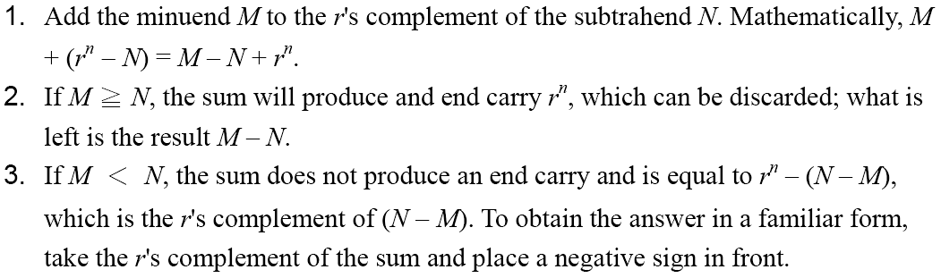
Complements
 Subtraction with Complements
◆ The subtraction of two n-digit unsigned numbers M – N in base r can be done as follows:

Slide 26
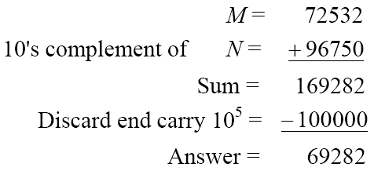
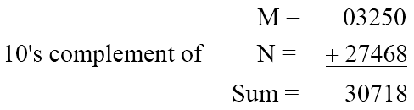
Complements
 Example 1.5
◆ Using 10's complement, subtract 72532 – 3250.
 Example 1.6
◆ Using 10's complement, subtract 3250 – 72532.
There is no end carry.
Therefore, the answer is – (10's complement of 30718) = − 69282.

Slide 27
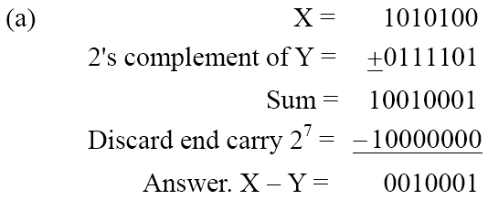
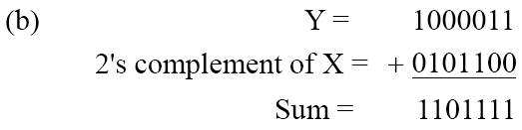
Complements
 Example 1.7
◆ Given the two binary numbers X = 1010100 and Y = 1000011, perform the subtraction (a) X – Y ; and (b) Y − X, by using 2's complement.
There is no end carry.
Therefore, the answer is
Y – X = − (2's complement of 1101111) = − 0010001.

Slide 28
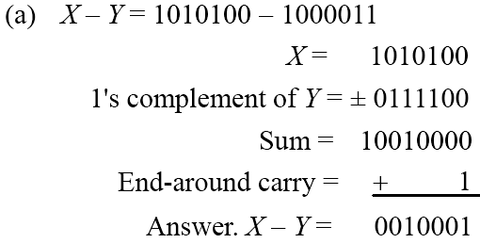
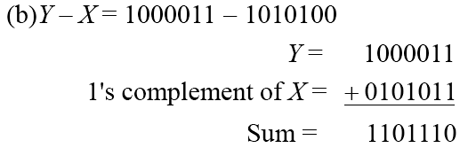
Complements
 Subtraction of unsigned numbers can also be done by means of the (r − 1)'s
complement. Remember that the (r − 1) 's complement is one less then the r's complement.
 Example 1.8
◆ Repeat Example 1.7, but this time using 1's complement.
There is no end carry, Therefore, the answer is Y – X = − (1's complement of
1101110) = − 0010001.

Slide 29
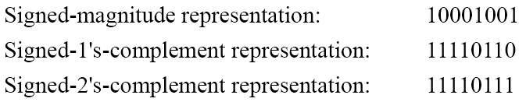
1.6
Signed Binary Numbers
 To represent negative integers, we need a notation for negative
values.
 It is customary to represent the sign with a bit placed in the leftmost position of the number since binary digits.
 The convention
negative.
 Example:
is
to
make
the
sign
bit
0
for
positive
and
1
for
 Table 1.3 lists all possible four-bit signed binary numbers in the
three representations.

Slide 30
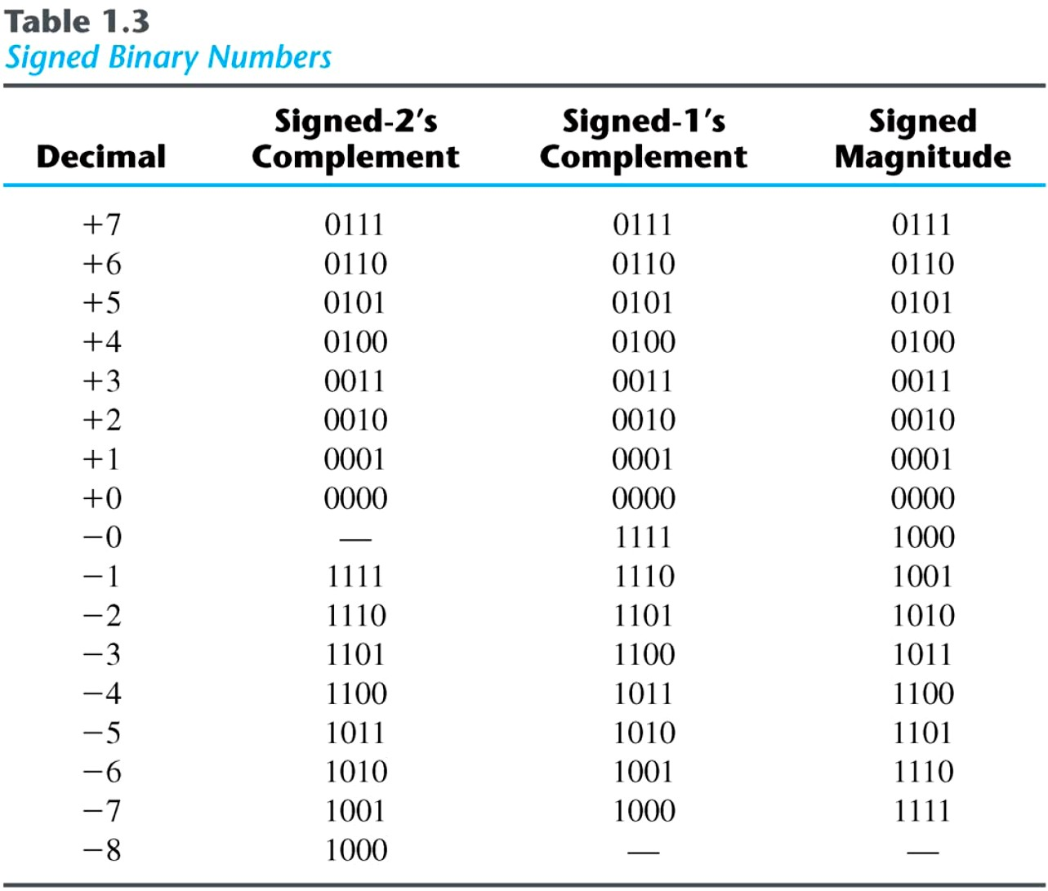
Signed Binary Numbers

Slide 31
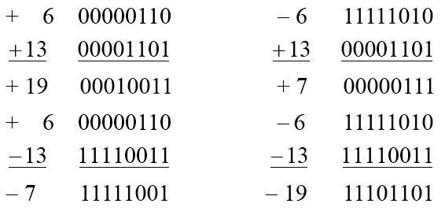
Signed Binary Numbers
 Arithmetic addition
◆ The addition of two numbers in the signed-magnitude system follows the rules of ordinary arithmetic. If the signs are the same, we add the two magnitudes and
give the sum the common sign. If the signs are different, we subtract the smaller
magnitude from the larger and give the difference the sign if the larger magnitude.
◆ The addition of two signed binary numbers with negative numbers represented in
signed-2's-complement form is obtained from the addition of the two numbers, including their sign bits.
◆ A carry out of the sign-bit position is discarded.
 Example:

Slide 32
Signed Binary
Numbers
 Arithmetic Subtraction
◆ In 2’s-complement form:
1. Take the 2’s complement of the subtrahend (including the sign bit)
and add it to the minuend (including sign bit).
2. A carry out of sign-bit position is discarded.
(± A) − (+B) = (± A) + (−B)
(± A) − (−B) = (± A) + (+B)
 Example:
(− 6) − (− 13)
(11111010 − 11110011)
(11111010 + 00001101)
00000111 (+ 7)

Slide 33
Weighted and Non weighted Code
Weighted Code:-
In weighted code, each digit position has a weight or value. The sum of all digits multiplied by a weight gives the total amount being represented.
We can express any decimal number in tens, hundreds, thousands and so on.
Eg:- Decimal number 4327 can be written as
4327= 4000+300+20+7
In the power of 10, it becomes
4327= 4(10³)+3(10²)+2(10¹)+7(100)
BCD or 8421 is a type of weighted code where each digit position is being assigned a specific weight.
Non-weighted code:-
In non-weighted code, there is no positional weight i.e. each position within the binary number is not assigned a prefixed value. No specific weights are assigned to bit position in non –weighted code.
The non-weighted codes are:-
a) The Gray code b) The Excess-3 code

Slide 34
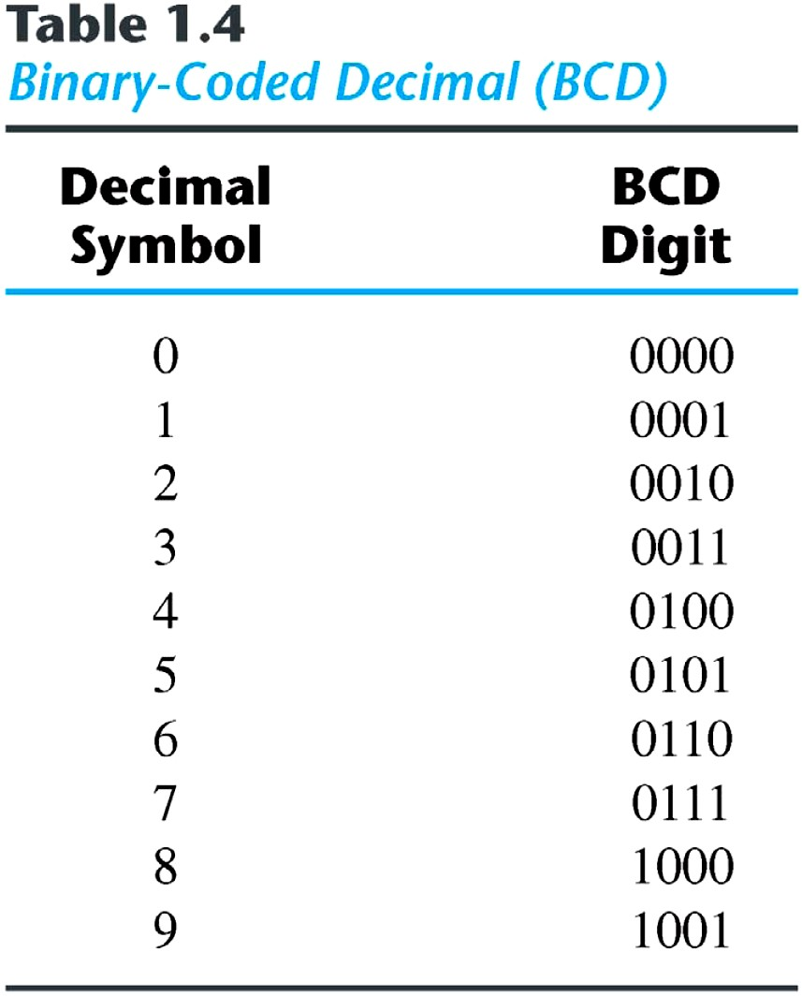
Binary
Codes
BCD or 8421 code:-
It is composed of four bits representing the decimal digits 0 through 9.
The 8421 indicates the binary weights of the four bits(2³,2²,2¹,20).
A number with k decimal digits will
require 4k bits in BCD.
Decimal 396 is represented in BCD with 12bits as 0011 1001 0110, with each group of 4 bits representing one decimal digit.
A decimal number in BCD is the same as its equivalent binary number only when the number is between 0 and 9.
The binary combinations 1010 through 1111 are not used and have no meaning in BCD.

Slide 35
BCD addition
Add two numbers as same as binary addition
Case 1: If the result is less than or equals to 9 and carry is zero then it is valid BCD.
Case 2: If result is greater than 9 and carry is zero then add 6 in four bit combination.
Case 3: If result is less than or equals to 9 but carry is 1 then add 6 in four bit combination.
Packed BCD
The BCD numbers corresponding to decimal numbers beyond 9 are called as packed BCD
Decimal (25)→ 0010 0101(Packed BCD)
9’s complement:
9’s complement of a BCD number can be obtained by subtracting it from 9.
10’s compliment:
10’s compliment is obtained by adding 1 to 9’s compliment

Slide 36
BCD or 8421 Code
Convert following to BCD form
a)47310 b) 31210 c) 25710 d) 11210
Convert following BCD to their decimal equivalent
a)10000110 b) 00110010.10010100
Convert the following binary number numbers to their BCD equivalent.
a)1101.012 b) 11.0112
(Binary to decimal Decimal to BCD)

Slide 37
Comparison of BCD with Binary
1. BCD is less efficient than binary
eg:- (78)10 = (0111 1000)BCD
=(1001110)2
To encode the same decimal number , BCD needs more no. of bits than binary . Hence BCD is less efficient as compared to Binary
2. BCD arithmetic is more complicated than binary arithmetic.
3. Advantage of a BCD code is that the conversion from decimal to BCD or vice versa is simple.

Slide 38
The Gray code
Introduction:
It is non weighted code in which each number differs from previous number by a single bit.
Binary to gray conversion:-
a)The MSB in the Gray code is same as the corresponding bit in the binary number.
b)Going from left to right, add each adjacent pair of binary bit to get next gray code bit and discard carry
Gray to binary conversion:-
a)The MSB is the binary code is same as corresponding digit in the gray code.
b)Add each binary digit generated to the gray digit in the next adjacent position and discard carry.

Slide 39
The Excess-3 code
It is an important BCD code , is a 4 bit code and used with BCD numbers
To convert any decimal numbers into its excess-3 form ,add 3 to each decimal digit and then convert the sum to a BCD number
As weights are not assigned, it is a kind of non weighted codes.
Convert the following into Excess-3 number
a)149 b) 2546 c) 152 d) 2694
Add the following numbers in excess-3 code
a) 108+789 b) 275+496

Slide 40
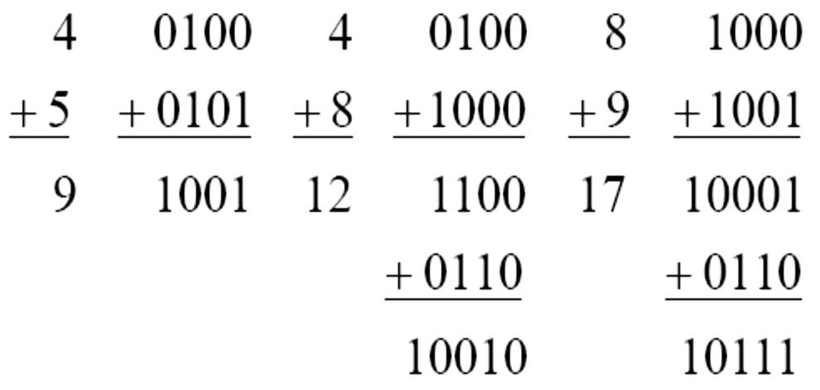
Binary Code
 Example:
◆ Consider decimal 185 and its corresponding value in BCD and binary:
 BCD addition

Slide 41
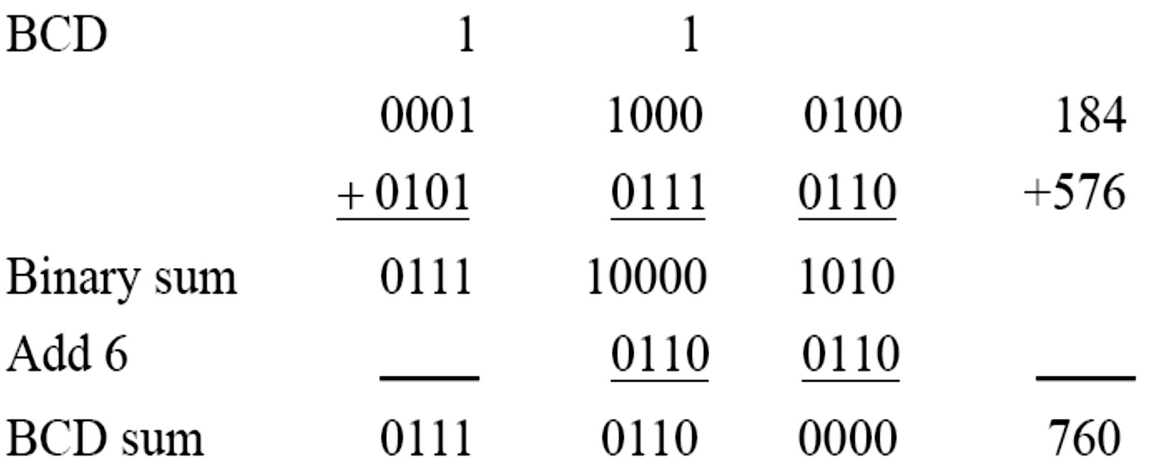
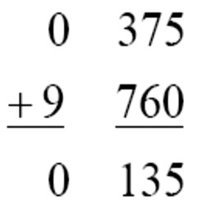
Binary Code
 Example:
◆ Consider the addition of 184 + 576 = 760 in BCD:
 Decimal Arithmetic: (+375) + (-240) = +135
Hint 6: using 10’s of BCD

Slide 42
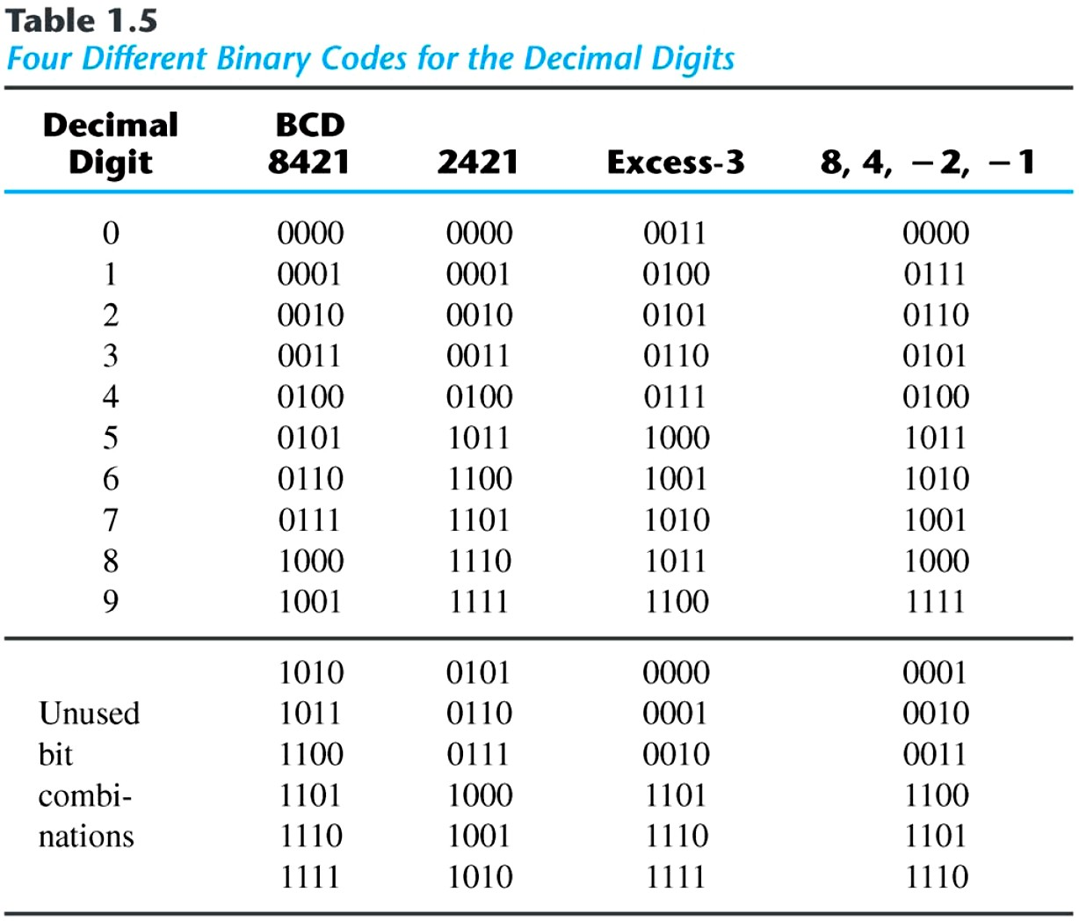
Binary Codes
 Other Decimal Codes

Slide 43
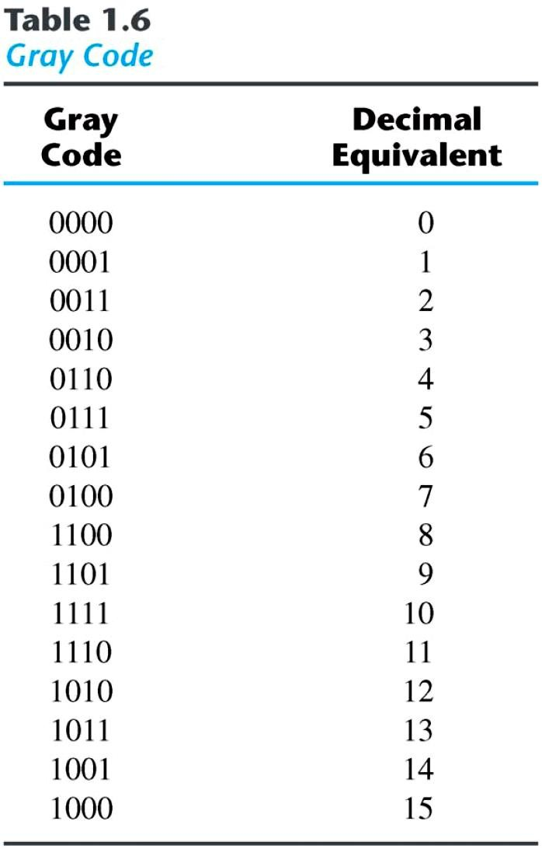
Binary Codes)
 Gray Code
◆ The advantage is that only bit in the code group changes in going from one number to the next.
»
»
»
Error detection.
Representation of analog data. Low power design.
000
001
010
011
100
101
110
111
1-1 and onto!!

Slide 44
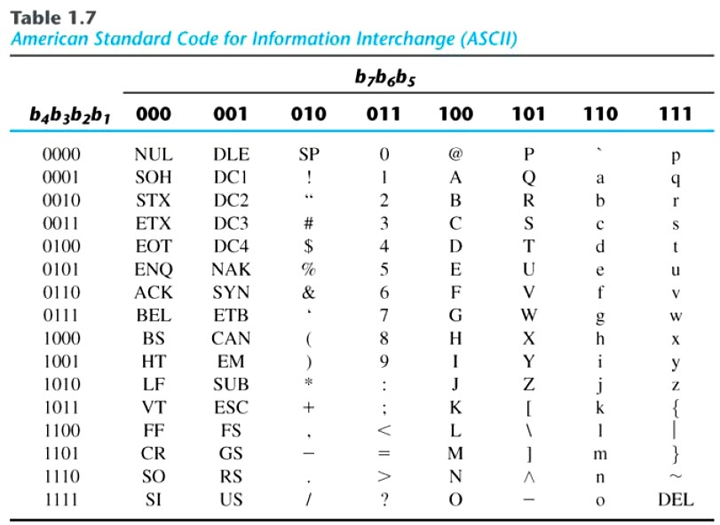
Binary Codes
 American Standard Code for Information Interchange (ASCII) Character Code

Slide 45
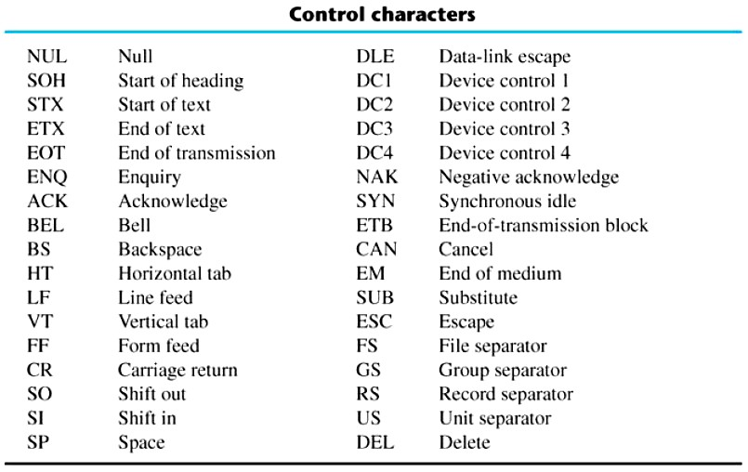
Binary Codes
 ASCII Character Code

Slide 46
ASCII Character Codes
 American Standard Code for Information Interchange (Refer to
Table 1.7)
 A popular code used to represent information sent as character- based data.
 It uses 7-bits to represent:
◆ 94 Graphic printing characters.
◆ 34 Non-printing characters.
 Some non-printing characters are used for text format (e.g. BS = Backspace, CR = carriage return).
 Other non-printing characters are used for record marking and flow control (e.g. STX and ETX start and end text areas).

Slide 47
ASCII Properties
 ASCII has some interesting properties:
◆ Digits 0 to 9 span Hexadecimal values 30₁₆ to 39₁₆
◆ Upper case A-Z span 41₁₆ to 5A₁₆
◆ Lower case a-z span 61₁₆ to 7A₁₆
» Lower to upper case translation (and vice versa) occurs by flipping bit 6.

Slide 48
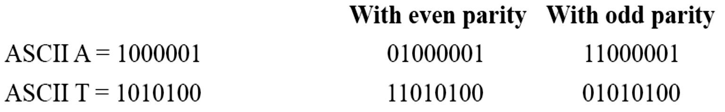
Binary Codes
 Error-Detecting Code
◆ To detect errors in data communication and processing, an eighth bit is
sometimes added to the ASCII character to indicate its parity.
◆ A parity bit is an extra bit included with a message to make the total number of 1's either even or odd.
 Example:
◆ Consider the following two characters and their even and odd parity:

Slide 49
Integrated Circuits (ICs)
An Integrated circuit is an association (or connection) of various electronic devices such as resistors, capacitors and transistors etched (or fabricated) to a semiconductor material such as silicon or germanium. It is also called as a chip or microchip. An IC can function as an amplifier, rectifier, oscillator, counter, timer and memory. Sometime ICs are connected to various other systems to perform complex functions.
Types of ICs
ICs can be categorized into two types
Analog or Linear ICs: They produce continuous output depending on the input signal. From the name of the IC we can deduce that the output is a linear function of the input signal. Op-amp (operational amplifier) is one of the types of linear ICs which are used in amplifiers, timers and counters, oscillators etc.
Digital or Logic ICs: Unlike Analog ICs, Digital ICs never give a continuous output signal. Instead it operates only during defined states. Digital ICs are used mostly in microprocessor and various memory applications. Logic gates are the building blocks of Digital ICs which operate either at 0 or 1.
Further there are certain ICs which can perform as a combination of both analog and digital functions.

Slide 50
Levels of Integration
During 1959 two different scientists invented IC’s. Jack Kilby from Texas Instruments made his first germanium IC during 1959 and Robert Noyce made his first silicon IC during the same year. But ICs were not the same since the day of their invention; they have evolved a long way. Integrated circuits are often classified by the number of transistors and other electronic components. They contain:
➢ SSI (small-scale integration): Up to 100 electronic components per chip
➢ MSI (medium-scale integration): From 100 to 3,000 electronic components per chip
➢ LSI (large-scale integration): From 3,000 to 100,000 electronic components per chip
➢ VLSI (very large-scale integration): From 100,000 to 1,000,000 electronic components per chip
➢ ULSI (ultra large-scale integration): More than 1 million electronic

Slide 51
A
Digital
Computer
Example
Memory
Control
unit
Datapath
CPU
Inputs: Keyboard,
Outputs:
CRT,
mouse, modem,
microphone
Input/Output
LCD, modem,
speakers
Synchronous or
Asynchronous?

